Slide 1
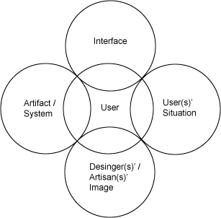
MMDE 11-150 Web Design
Lecture 8
→User Centered Design
Semester 102
Dr. James Birt

Slide 2
Announcements
Assignment One → Feedback
The Good, The Bad, The Ugly
Work through documentation ..\Assessment\Ass1\DocumentationAss1_150.docx
Quiz three this week
Start work on assignment two

Slide 3
Outline
What is UCD?
ISO 13407:1999
Applying user-centred guidelines
Designing websites for large companies
Measuring Design Effectiveness
Driving Customers Away

Slide 4
User-centred design (UCD)
This information is based on the ISO standard: 13407:1999
Note: 13407:1999 has been replaced by 9241-210:2010 – However
at this time there is limited materials on the new standard.

Slide 5
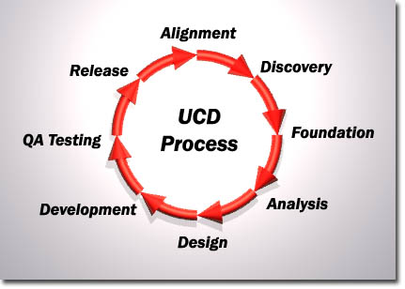
What is UCD?
Project methodology placing intended users of the website site at the centre of the design & development.
Does this by talking directly to the user at key points in the project to ensure requirements conformance.
The stages are carried out in an iterative fashion, with the cycle being repeated until the project's usability objectives have been attained.
This makes it critical that the participants in these methods accurately reflect the profile of your actual users.

Slide 6
ISO 13407:1999: Human-centred design processes for interactive systems
Provides guidance on achieving quality by incorporating UCD throughout the websites life cycle.
Describes UCD as a multi-disciplinary activity, incorporating:
Human factors
Ergonomics knowledge
GOAL: enhancing effectiveness, productivity, working conditions, safety & performance.

Slide 7
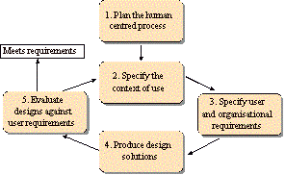
ISO 13407:1999: Activities
Requirements gathering - Understanding and specifying the context of use
Requirements specification - Specifying the user and organisational requirements
Design - Producing designs and prototypes
Evaluation - Carrying out user-based assessment of the site

Slide 8
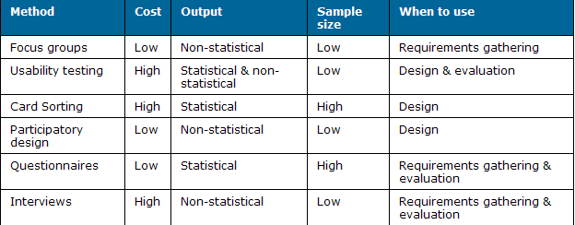
Popular UCD methods

Slide 9

Focus groups
Involve participants (group of intended/actual users) of the web site to share their thoughts, feelings, attitudes and ideas on a certain subject.
Focus groups are most often used as an input to design.
They generally produce non-statistical data and are a good means of getting information about a domain
e.g. What tasks do people do on a daily
basis
It's necessary to have an experienced
moderator and analyst for a focus group
to be effective.

Slide 10
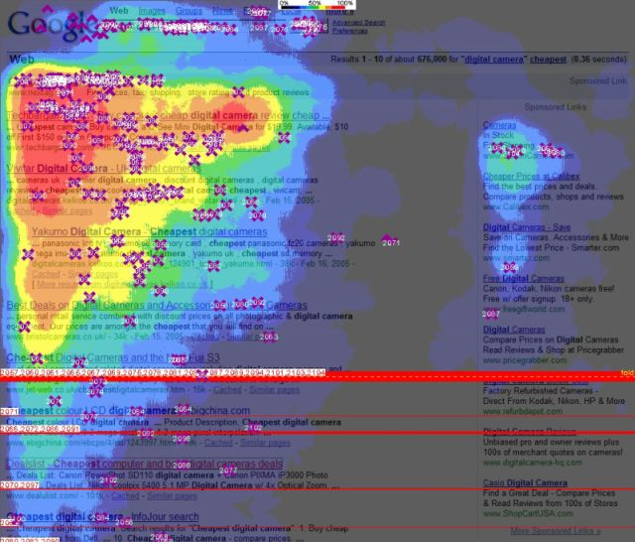
Usability testing
Evaluate a site by collecting data from people as they use it.
A person is invited to attend a session in which they'll be asked to perform a series of tasks while a moderator takes note of any difficulties they encounter.
Users can be asked to follow the think-aloud protocol which asks them to verbalise what they're doing and why they're doing it.
You can also time users to see how long it takes them to complete tasks, which is a good measure of efficiency.
Usability testing can be used as an input to design or at the end of a project. It represents an excellent way of finding out what the most likely usability problems with a site are likely to be.
Usability testing can be used to generate non-statistical or statistical data.
Usability testing requires some form of design to be available to test(prototype) – this can even be paper!!
Google heat map: How users
view a Google search page

Slide 11
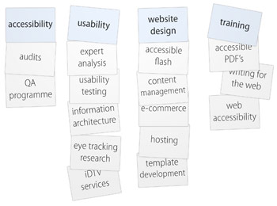
Card sorting
Method for suggesting intuitive structures or categories.
A participant is presented with an unsorted pack of index cards. Each card has a statement written on it that relates to a page of the site.
The participant is asked to sort these cards into groups and then to name these groups.
The results of multiple individual sorts are then combined and analysed statistically.
Card sorting is usually used as an input to design. It's an excellent way of suggesting good categories for a site's content and deriving its information architecture.
Card sorting can be used generate statistical data.
Provide participants with a trial run on some easy cards (e.g. sports, animals, etc.) so they know what they are expected to do and result in a more productive session.

Slide 12
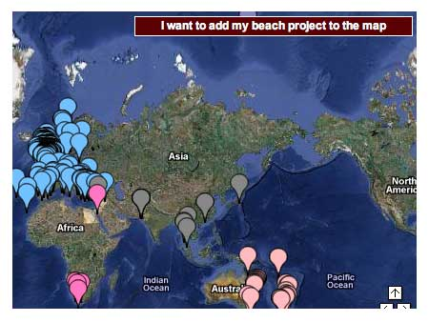
Participatory design
Ask end users opinions on design issues
Involves end users in the design and decision-making processes
Participatory design is usually used for generating prototypes
Participatory design sessions can be very fluid and require an experienced moderator with thorough knowledge of the domain to guide them.
Google maps: Is an example of a real time
design involving millions of participants

Slide 13
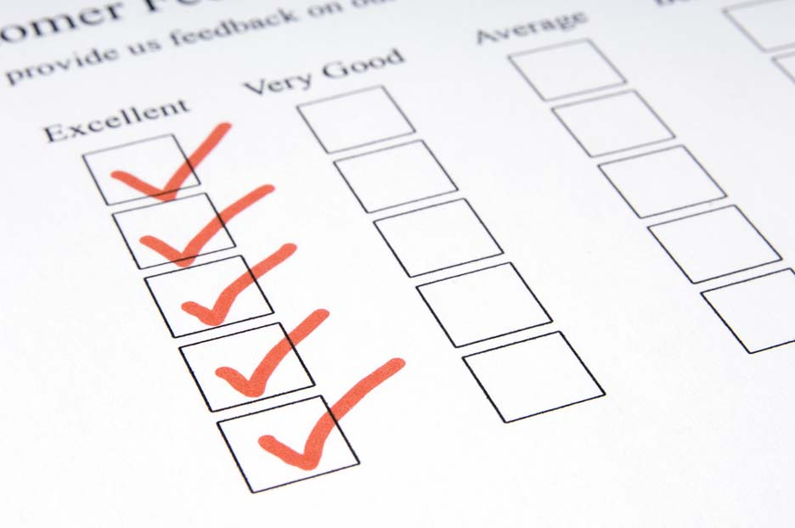
Questionnaires
Means of asking users for their responses to a pre-defined set of questions and are a good way of generating statistical data.
Questionnaires are usually employed when a design team:
Can only gain remote access to users of a site
Is seeking a larger sample size than can be realistically achieved through direct contact
Questionnaires allow statistical analysis of results, which can increase a study's credibility through its scientific appearance.
This makes it all the more important that the questionnaire is well-designed and asks non-biased questions.

Slide 14

Interviews
Involves one or more interviewers speaking to one participant at a time.
The advantages of an interview are that a participant's unique point of view can be explored in detail. It is also the case that any misunderstandings between the interviewers and the participant are likely to be quickly identified and addressed.
The output of an interview is almost exclusively non-statistical - it's critical that reports of interviews are carefully analysed by experienced practitioners.
Interviews are usually employed early in the design
process in order to gain a more detailed understanding
of a domain/area of activity or specific requirements.
Interviewing places a high premium on the experience
and skill of the interviewer and analyst and can be
expensive.

Slide 15
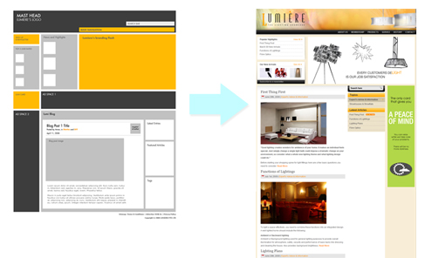
Applying user-centred guidelines
The most used form of USD application is visualising the data gathered into a series of pictures.
By translating the vast amount of information gathered into visualisations helps us make sense of data.

Slide 16
Usability guidelines for visualisations
Be intuitive: Don't have a great visualisation with hidden functionalities. People must beable to understand
Help viewers make sense of complex information: The power of visualisations lies in their ability to display complex information on a single visual canvas. Think about personalisation.
Use an appropriate mental model: A good visualisation needs to match the way users conceptualise a specific topic.

Slide 17
Usability guidelines for visualisations (cont)
Follow general usability guidelines:
Good colour contrast
Readable font size
Clear titles
Clear Instructions
Good zooming and panning options
Clear feedback
Allow viewers to gain insight from the visualisation: Does the visualisation allow users to make clear conclusions.

Slide 18
Designing Enterprise Sites For Large Companies

Slide 19
Designing websites for large companies
Many large companies experience problems with poor user experience.
This is due to:
Hastily put together applications by an internal team in response to an urgent business need.
Employees using an array of applications sourced from multiple suppliers.
Product lacking any commonality in design.
Poor Management of the product requirements.
Company bosses believing that poor user experience isn’t a big issue.
The following are guidelines to help with designing webpages for larger companies.

Slide 20
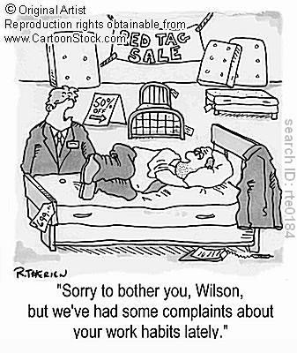
1. Study how people work, in their workplace
User Research:
Conduct before design phase.
Important in a business environment, where requirements can be complicated.
Designers can be faced with unfamiliar domains.
Requirements often collected by management & passed on to the designers.
THE RISK: how employees actually work is not always how their management thinks they work.

Slide 21
1. Study how people work, in their workplace (cont)
Why Research?
Talk directly to potential users of an application.
Visit their workplace to understand the full context of their work.
Discover any workarounds that are currently employed.
Uncover any workplace disruptions that may interrupt the use of an application.
Workplace politics and social dynamics that affect how people collaborate.

Slide 22
2. Consider the balance between novice and expert users
Enterprise sites have > average proportion of 'expert' users
That is, users who use the application frequently in their day-to-day work.
These users become very familiar with the application and take the time to learn more complex interactions.
The goal is to make these interactions understandable and useable to make their life easier.

Slide 23
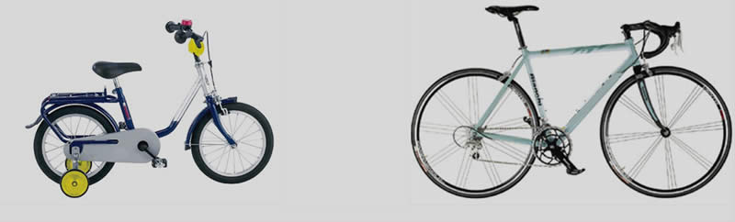
2. Consider the balance between novice and expert users (cont)
It’s also important that enterprise sites accommodate novice users as well.
New employees using an application for the first time, or other occasional users must be offered clear, simple workflows.
These workflows should focus on executing key tasks quickly and hide the complexities that only expert users will appreciate.
Doing so will help eliminate the need for training new users and re-training infrequent users, thus saving time and money.

Slide 24
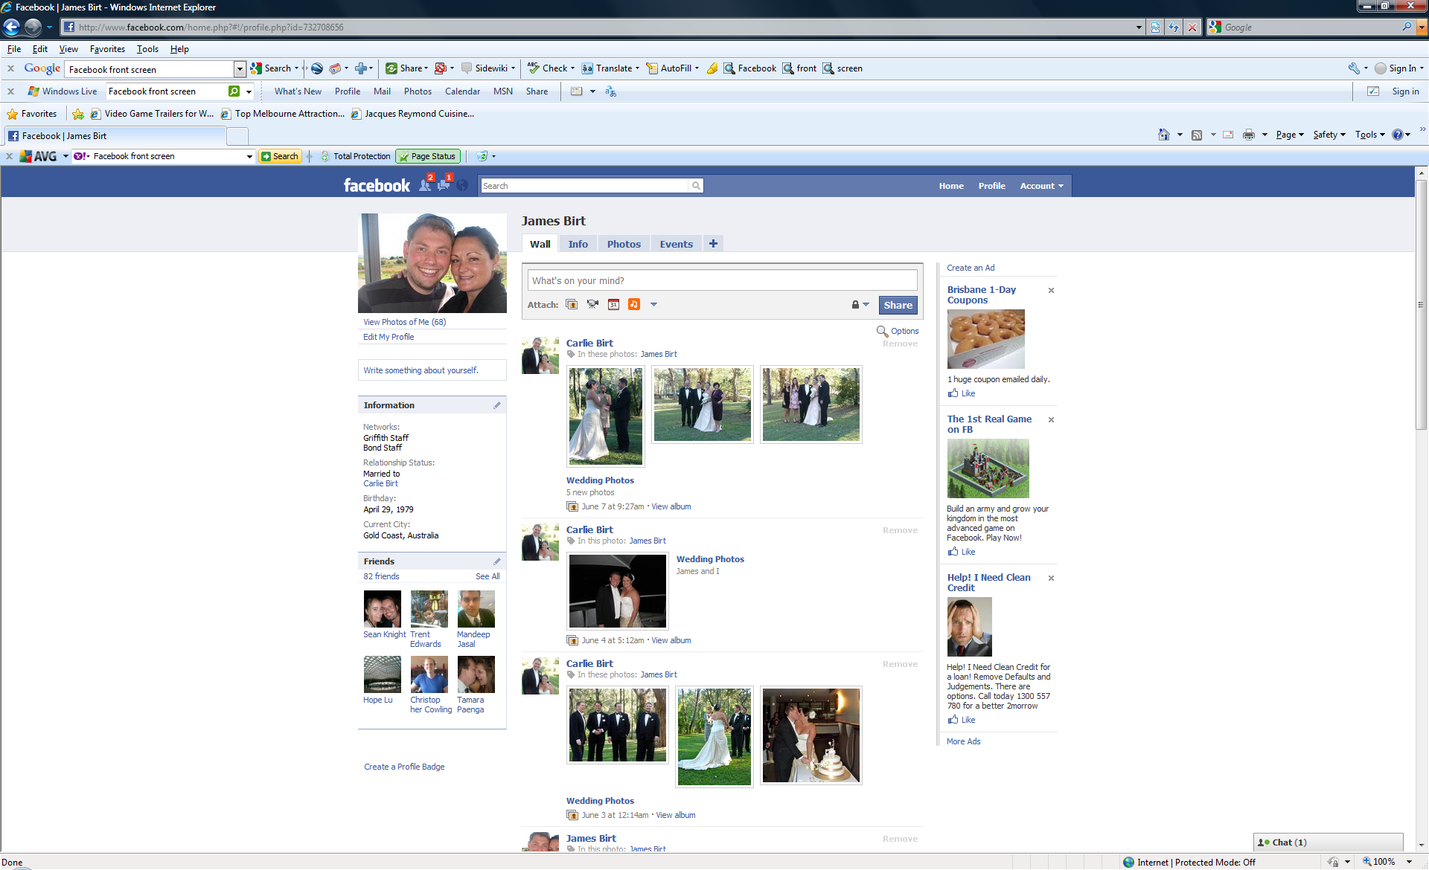
3. Allow for customisation and personalisation
If you think it’s annoying to use a website once that doesn't work the way you want, imagine having to do this every day.
The problem is, no matter how many potential users you talk to, there's always going to be a variation in the way people think and work.
It's important to recognise this variation, and allow users of your application to customise how it works.
For example, consider providing a personalised home screen where people can add their own shortcuts and views of information.

Slide 25
3. Allow for customisation and personalisation (cont)
If your application features a search facility, where users may spend time composing a complex set of search criteria, you should also think about allowing them to save these searches so they can repeat them later.
The important thing is consider customisation carefully.
If you find that you need to make most aspects of an application customisable, it may mean that you're not really certain of users' needs.
Users are likely to take some time before they start fully understanding and customising an application they use, so sensible defaults still need to be provided for novice users.

Slide 26
4. Open up your data
It is rare for Enterprise Sites to work in in isolation.
More often than not, corporate users have to use an array of applications to get their work done.
Unless this scenario has been considered from the beginning, it's often difficult to get applications to work together and seamlessly exchange data.
Users often have to resort to manual workarounds to keep things moving.

Slide 27


4. Open up your data (cont)
To avoid manual work arounds:
Allow users to export data in a format that they're familiar with e.g. Excel spreadsheets.
Allow users to easily print out information where possible - not everyone wants to review a large amount of information on a computer screen.
Check if there are any industry-standard data formats relevant to your application domain, and conform to these formats where possible to allow for seamless integration with other applications.

Slide 28
5. Collect ongoing user feedback
After an application is deployed and appears to work, it's all too easy to forget about it and devote all resources to other projects.
However, even after initial problems have been fixed, more things can come up further along the way.
It's only after users have been using an application for a while that you can understand if there's scope for further optimising.
For example, you may find that there are certain tedious tasks that users need to frequently repeat, and such tasks could be automated.

Slide 29
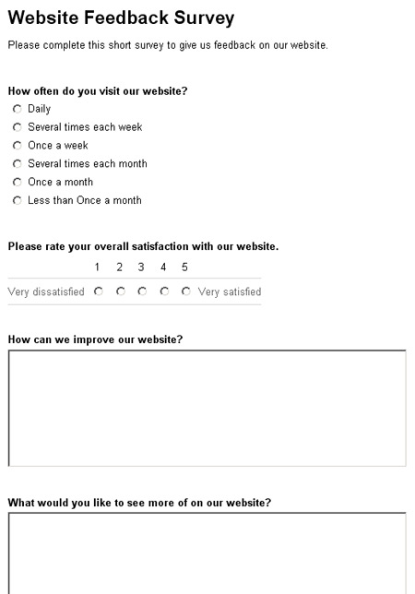
5. Collect ongoing user feedback (cont)
You may also need to provide additional functionality to sift through the growing amount of data handled by an application as time passes.
Fortunately, it shouldn't be difficult to collect such feedback: users can be very vocal if something that they have to use every day doesn't work as they expect.
Consider providing a way to capture feedback from within your application → allowing users to easily report any issues they have.
If your application is supported by a helpdesk, support staff can also provide very useful feedback on the issues that users are facing and the changes that they're requesting.

Slide 30
How can we measure design effectiveness?

Slide 31
Making an impact: Measuring web design effectiveness
Everyone wants to make a great website.
A good start is to ensure aesthetic design and user research are intimately related.
Why do this?
Most sites work within an acceptable context.
E.g. Very few sites fall over under heavy traffic or contain broken links.
But there's a need for you to differentiate your site from the others.

Slide 32
How to differentiate?
The best ways to differentiate:
Be easy to use
Pleasant on the eye
Encourage return visits
The aesthetic/emotional reaction to a site has a massive influence on this.
Most people have made a judgment on the quality of your site less than half a second after laying eyes on it!
Before any form of interaction with your site most people will have already drawn a conclusion about whether it's worth their time.
This means the initial impression needs to be overwhelmingly positive.
So, How do you do this?

Slide 33
ANSWER: Good aesthetic design
With areas like usability there are many acceptable techniques e.g.
Expert evaluation
Usability testing
Cognitive walkthrough
This is a lot harder with aesthetics
Attempting to assess the aesthetic or emotional reaction to a site is a much more difficult process
Most people use their own judgement, but there are more scientific methods available.

Slide 34
Measuring Aesthetics?
Emotional reactions to websites can be measured in 2 ways:
Physically
Through personal accounts
Physical reactions include:
pupil dilation
facial expressions
leaning towards or away from the screen
Personal accounts:
Need participants to say, in a questionnaire, how they feel/felt when using the site.

Slide 35
Example methods
There are several methods available that attempt to measure peoples reactions to a site. None are entirely reliable, but all will give you a clear idea of how participants really find your site:
Mood after use
Facial expressions
Estimated time of use
Sensory Quality Assessment Method – SEQAM
Perceived target market
Opposing scale questionnaires
Direct feedback

Slide 36
Mood after use
A questionnaire can be used to measure the mood of the participant after using the site.
This is more reliable if the change in mood is measured before AND after use.
You know your site's working if the average mood takes a jump positively after use.
However, there's a weakness in this method:
How can you be sure any change in mood is related to your site, and not to something the participant was thinking about?
In order to ensure your results are reliable you need to conduct several sets of tests and use different methods to ensure statistical significance.

Slide 37
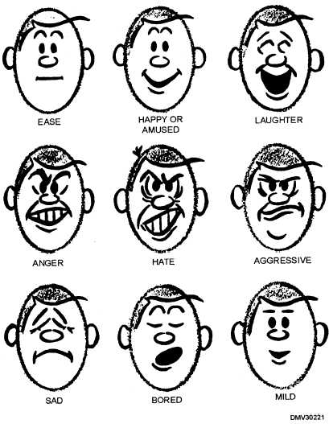
Facial expressions
As people use sites, they express themselves.
They smile
They frown
They look confused
Simply define which moods you're looking for (ensure both positive and negative are covered) and keep a tally as people use the site.
The more positive expressions (or at least lack of negative expressions) the better.
The problem with this method is the risk of missing or misinterpreting people's facial expressions.

Slide 38
Estimated time of use
A simple method to measure how engaged a participant was after using a site is to:
Ask them to report the length of time they felt they used your site for
Compare this to how long they actually used it for
This often creates a situation where participants:
Overestimate the time they aren't enjoying themselves
Underestimate the time they are enjoying themselves
This method is reliant upon participants being unaware of the time throughout using the site
Can be affected by what they are asked to do - someone asked to do something dull may overestimate the time taken no matter how good the site is.

Slide 39
SEQAM - Sensory Quality Assessment Method
A method particularly popular in the car design industry.
Participants are not shown the design as a whole.
They are shown a series of alternative design parts and asked their opinions of each.
Using this method means the participant cannot see the whole design, and testing needs a large number of these alternative parts.

Slide 40
Perceived target market
This method requires participants to define the target market of the site.
This will give you great insight into how participants perceive your site.
Participants may struggle to frame what they see and feel into a “target market”.
You will need to define areas (age, interests, etc) for participants to fill out that will guide them through the process.

Slide 41
Opposing scale questionnaires
This method requires participants to fill in scale questionnaires between 2 extremes of feelings
Ee.g. “How would you rate your experience with the site? Give 1 for pleasant, 5 for unpleasant”.
This method requires heavy use of statistical analysis to ensure the results are reliable - but limited conclusions can be drawn from the results without this.
This method often works best when 2 or more sites are compared, as participants give much more varied scores.

Slide 42
Direct feedback
Simply ask participants how they found the site after using it.
This method is surprisingly unreliable, people adjust what they say according to how they think you want them to answer.
There have been times when a participant is literally unable to do anything on a site, yet somehow decided it was worthy of a 9/10!

Slide 43
How to drive away your site visitors, fast!
Pop up ads
Being required to install extra software to view site content
Dead links
Confusing navigation
Required registration to access content
Slow-loading pages
Ineffective site search tools

